Slide 1

Pattern Patent
Visualization
Notes:
# only scratched the surface of the data for the limited time and resources

Slide 2
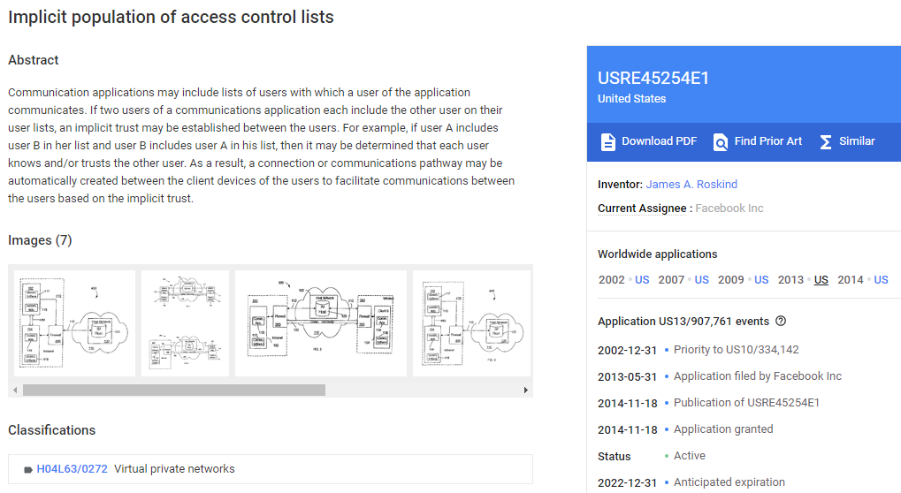
https://patents.google.com/patent/USRE45254

Slide 3
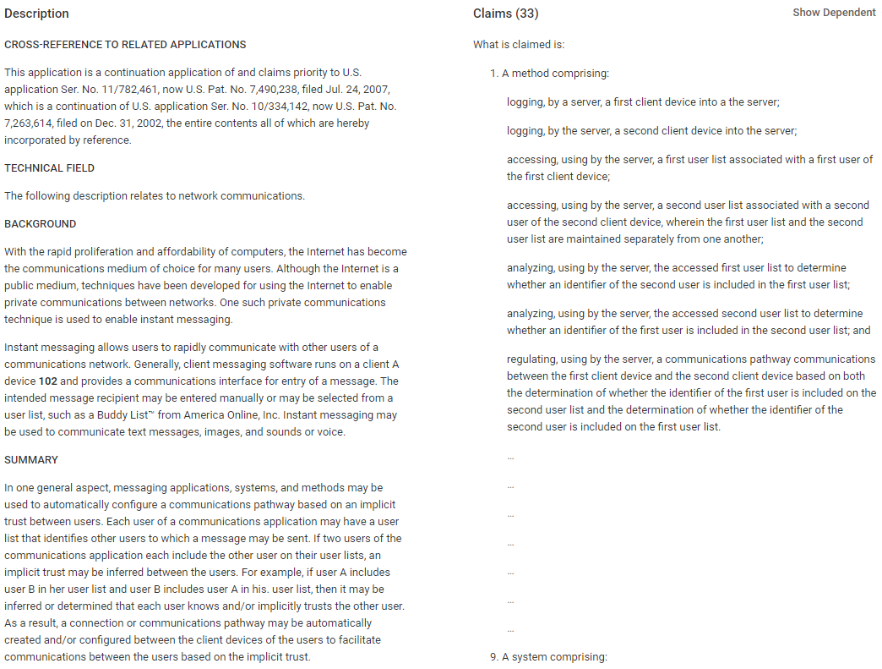
https://patents.google.com/patent/USRE45254

Slide 4
Previously on Pattern Patent …
Would you afford the time cost?
Check out Hamlet App
Is your case likely to be patented?
Check out Hamlet App
Which attorney are you talking to?
Check out HesJustNotThatIntoYou App
Would you want to live around other inventors?
If yes, move to CA, Ivy Leauge, RTP areas
Do you know the examiner’s sweet spot?
25, 135, 837 rules

Slide 5
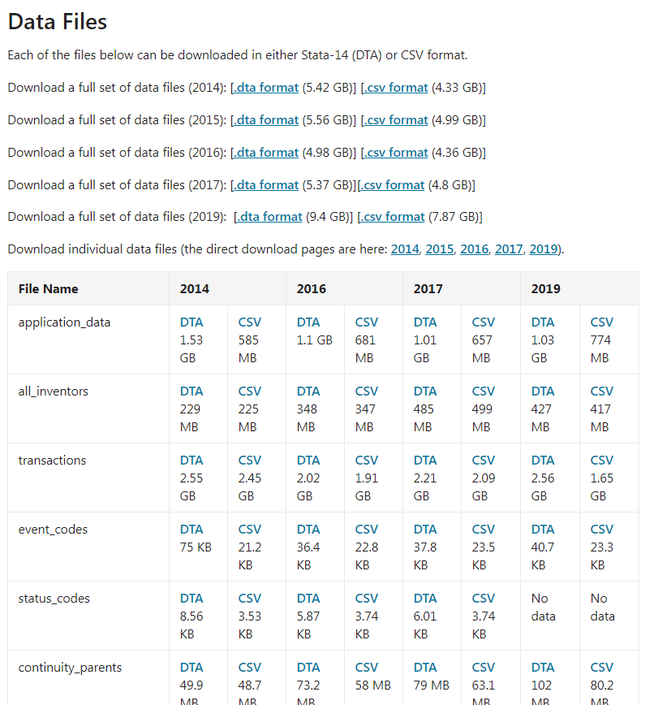
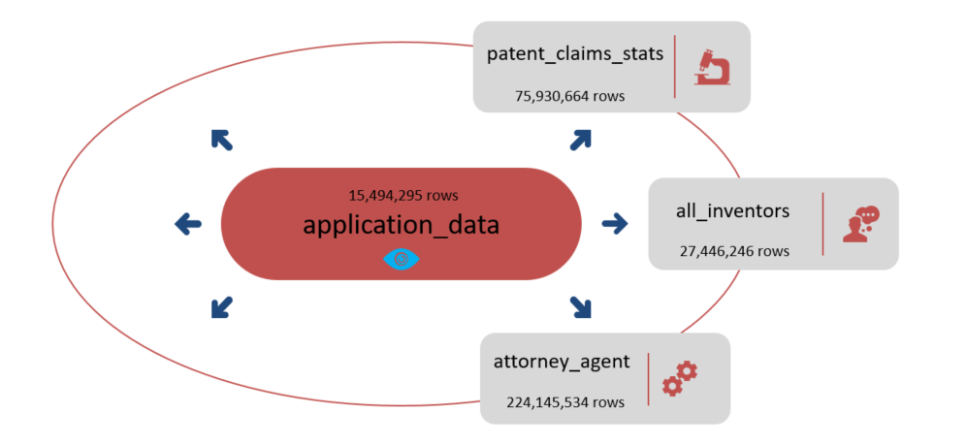
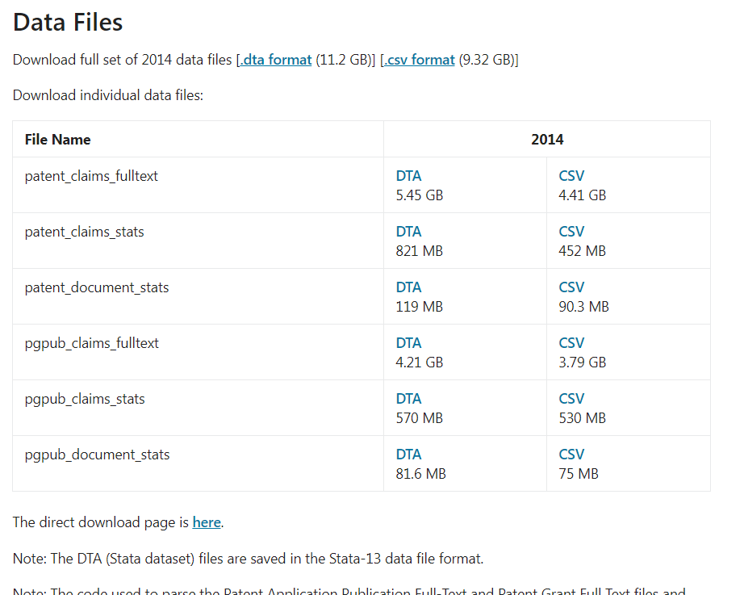
Extract
Data Source
https://www.uspto.gov/learning-and-resources/electronic-data-products/patent-examination-research-dataset-public-pair
https://www.uspto.gov/learning-and-resources/electronic-data-products/patent-claims-research-dataset

Slide 6
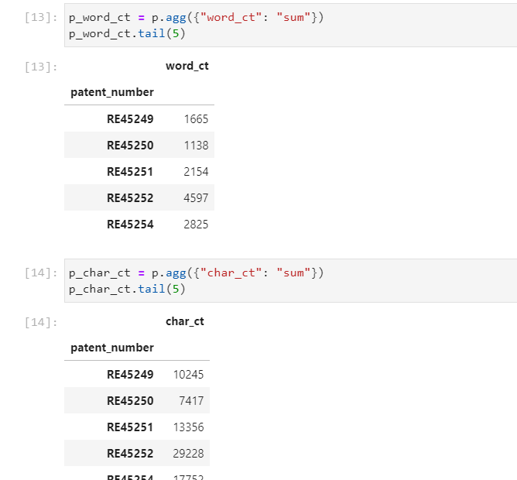
Transform
Data cleaning and transformation (cleaning, joining, filtering, grouping, merging, aggregating, etc) are performed in Python
Notes:
Huge work finished in Jupyter Lab

Slide 7
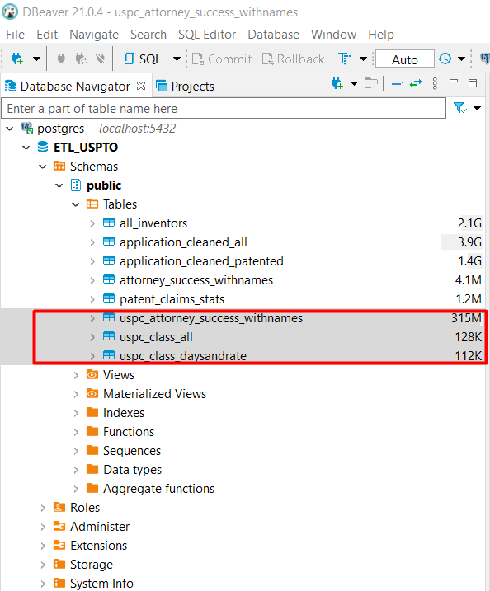
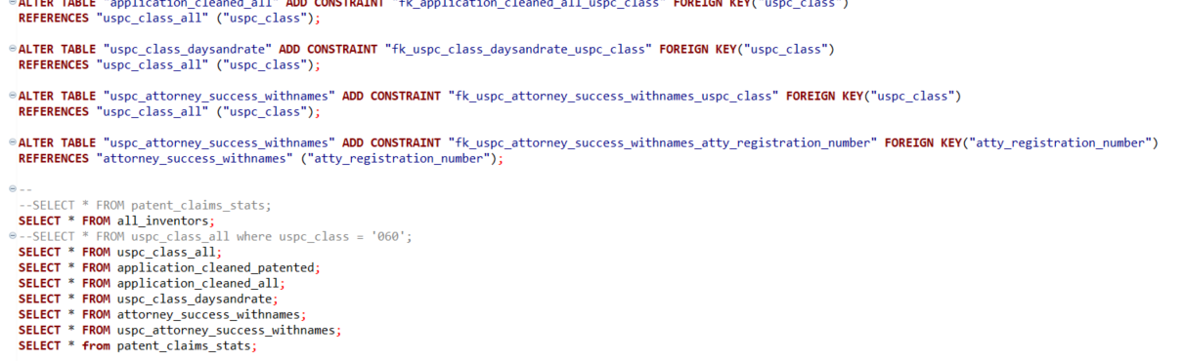
Load
engine = create_engine(f'postgresql://{rds_connection_string}')
PostgreSQL/Beaver
Notes:
From jupyter lab to postgresql

Slide 8
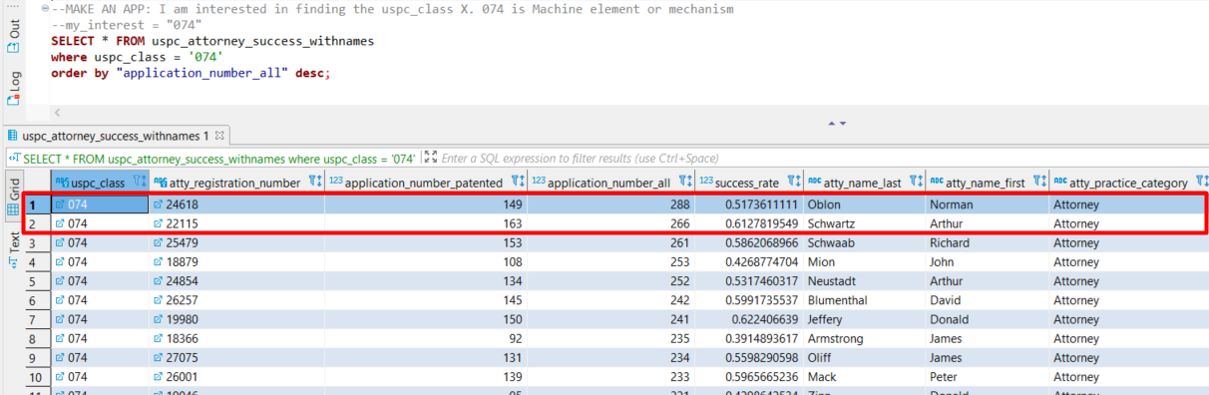
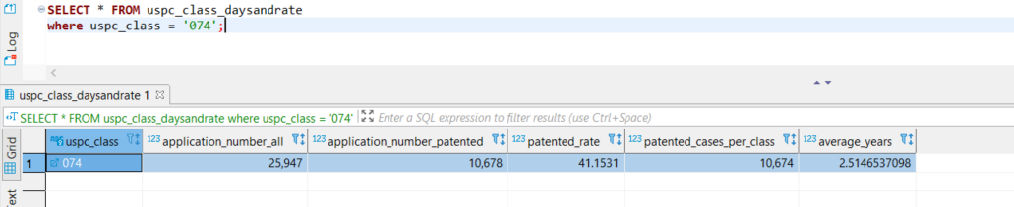
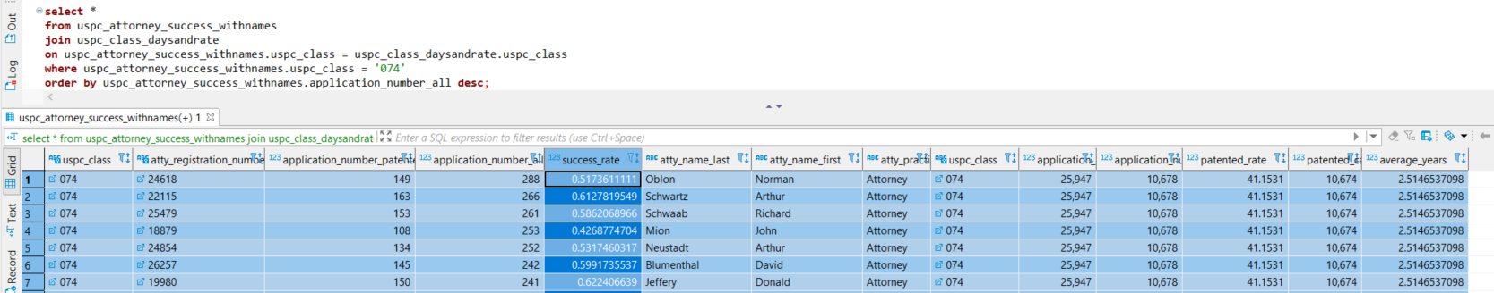
Load
HesJustNotThatIntoYou App
Hamlet App
Interstellar App
Notes:
I break down by classes and then check on attorney! NO visualizations yet. Dry data.

Slide 9
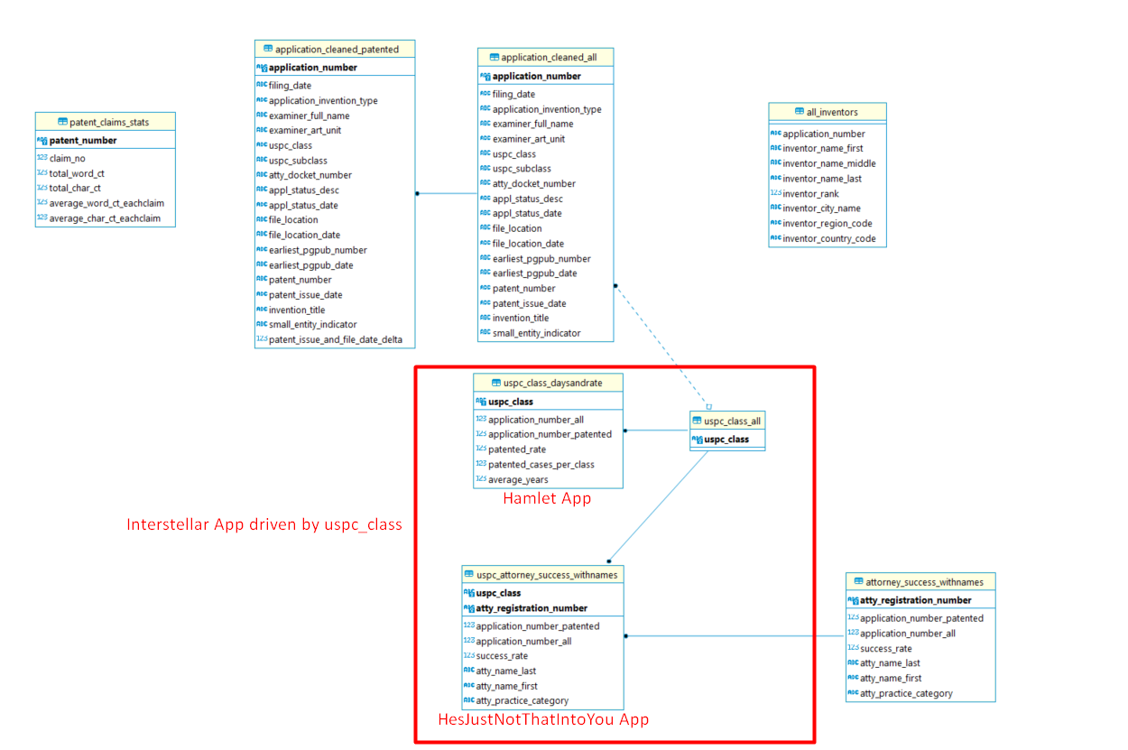
Load
Notes:
3 tables that will be visualized.

Slide 10
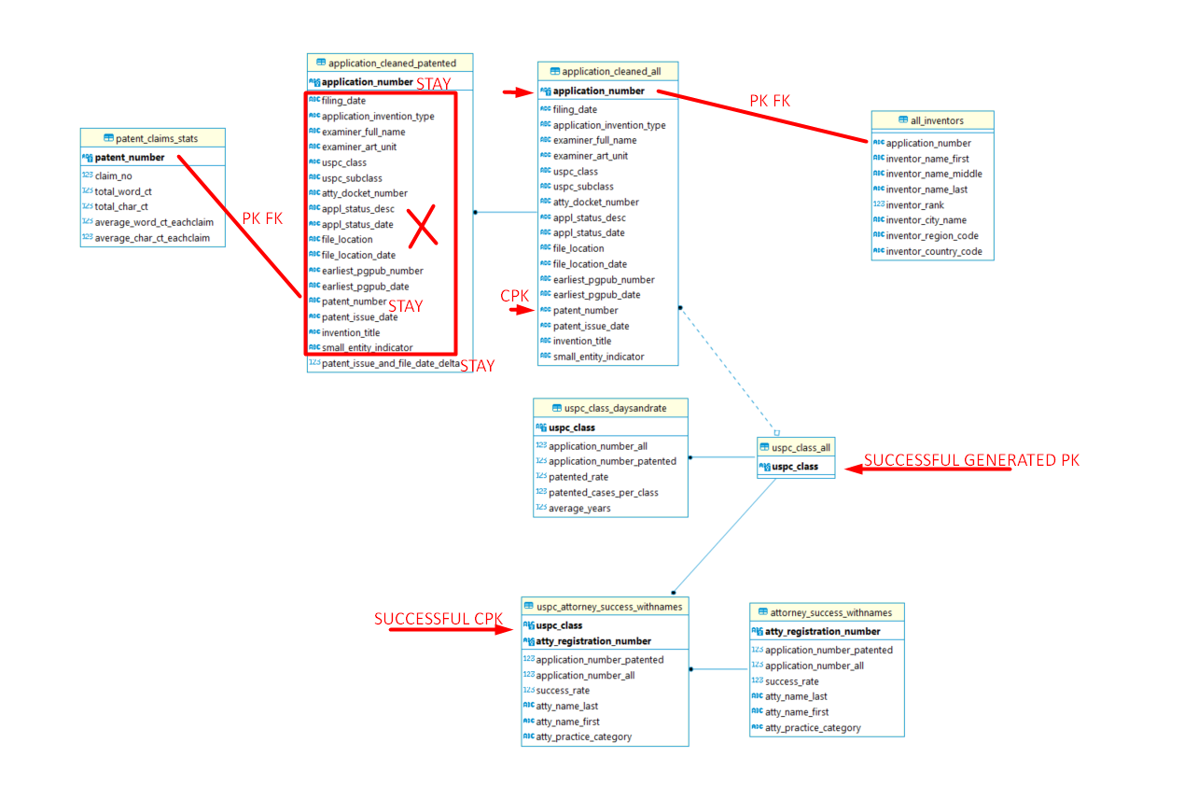
Load
Modified Version
Notes:
Better PostgreSQL schema

Slide 11
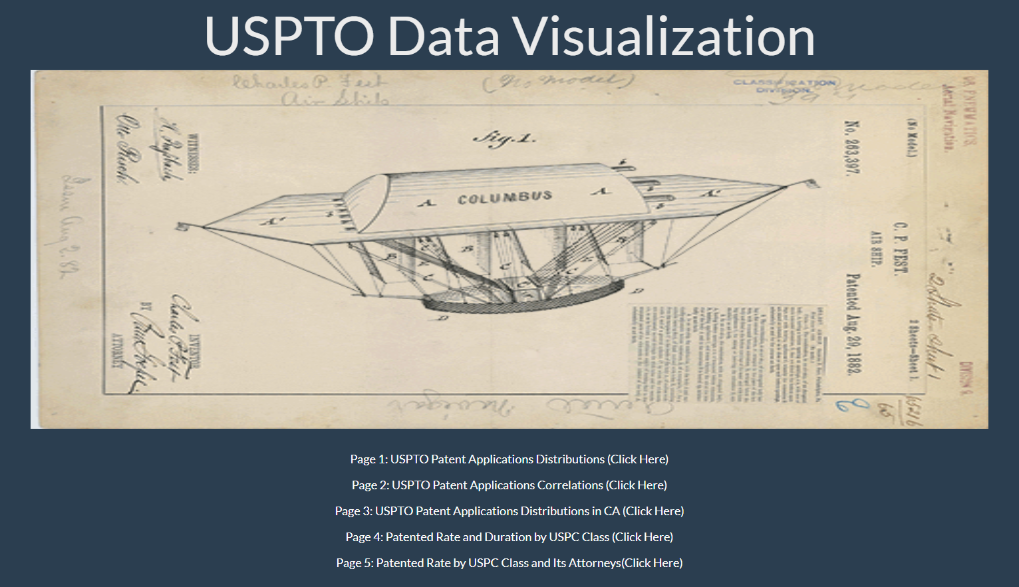
Visualization

Slide 12
Copyright and Trademark Notice
All material in this presentation, including design, text, images, charts, are owned by Liang Gong, protected by US copyright and trademark laws. All rights are reserved by Liang Gong. Content may not be copied, reproduced, transmitted, distributed, downloaded or transferred in any form or by any means without Liang Gong's prior written consent, and with express attribution to Liang Gong. The only exception is that one temporary copy may be downloaded into a single computer's memory and one unaltered permanent copy may be used by the viewer for personal and non-commercial use only, with an attached copy of Liang Gong 's written consent. No part of the downloaded copy may be subsequently reproduced, disseminated or transferred. Copyright infringement is a violation of federal law subject to criminal and civil penalties. (For permission to reprint, please contact Liang Gong via email at gongliangtju@gmail.com)

